Slide 1
Key Insights from Data set #1
For Chairman of the Board, President, Executive Vice President, Chief Financial Officer, Chief Accounting Officer
Presented By: Zhao Zheng

Slide 2
Introduction and Overview
Company X generates sales across different product SKUs through appointment booked by customers
Data is from 2013 to 2015 across four Canadian divisions
Purpose of this presentation is to highlight key insights from the data

Slide 3
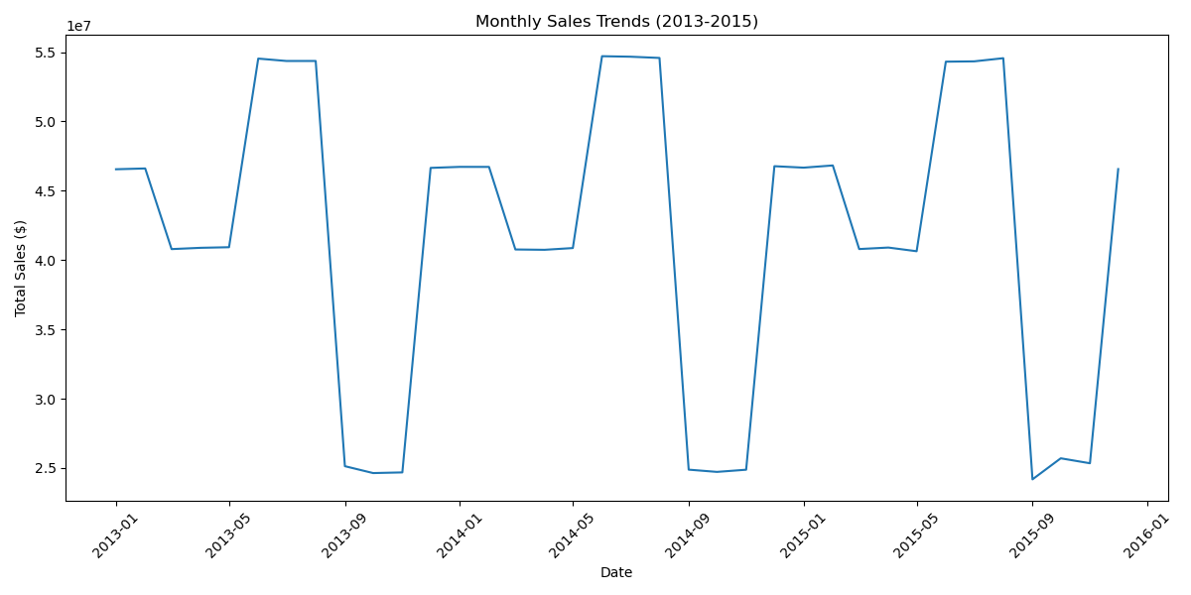
Historical Patterns and Trends
Seasonal trends observed in sales, with peaks during mid-year
Anomalies such as high customer numbers need verification

Slide 4
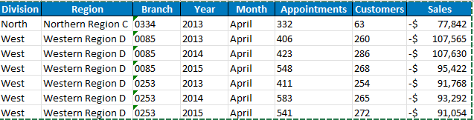
Negative Sales Implications
Based on the negative sales, it is reasonable to conclude that human errors occurred as it is not valid to have negative sales. Majority of the errors occurred in the West Division and specifically Western Region D, this could indicate lack of training in staffs who are responsible to record sales in Western Region D.
Moreover, all negative sales occurred in April in the years between 2013-2015. In addition, April could be the month is launching a specific SKU which could trigger the negative sales incident.
Comparing Northern Region C and Western Region D, it seems like the error in Northern Region C is a non-recurring as it occurred one time only in 2013. As for the West Division, the branches # 0085 and #0253 have a history to making the errors and I would suggest to train the staffs who work in those two branches.
Overall, I will remove these negative values to properly reflect the correct sales to avoid potential misleading of financial status

Slide 5
Thank you for your attention !
Refer Graphs.ipynb for details of the visualizations shown in the presentation
Refer Data Set – Dataset_1_Final_Response for the data cleaning processes

